Slide 1
PROJECT INTRODUCTION
Project Name: GGE300_BMS 20S 40A NMC 72V
Objective-.Make a BMS with following specification.Cell no.=20cell,Cell type=NMC,Battery nominal voltage=72V,Continuous discharging current=40A
Scope-A Battery Management System (BMS), which manages the electronics of a rechargeable 20 cells , whole combines a battery pack thus becomes a crucial factor in ensuring safety. It safeguards both the user and the battery by ensuring that the cell operates within its safe operating limits .This particular BMS will be used for operating 72V battery pack having all controlling features for the safe limits of the working of the cell.
Measurement Goals - Schedule Variance:±20%,Product Defect Density:0.10±0.02,Project’s Process Defect Density:0.20±0.02.
Link to Project Data :http://192.168.100.9:8080/svn/BMS/BMS_20S_40A/
Team Size: 10 Nos.
Effort Size: 132hrs.
Time Line : 19-07-2022 to 31-08-2022
Actual Scheduled Start to Finish Date: 19-07-2022 to 31-08-22
Target Customer :In-house use and domestic Market

Slide 2
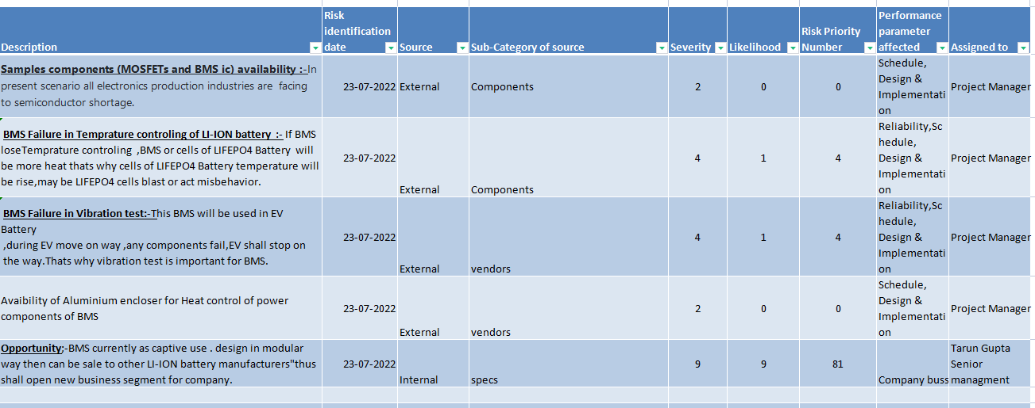
Risk Identification, Analysis and Opportunity
http://192.168.100.9:8080/svn/BMS/BMS_20S_40A/GGE300_RSKMTX.xlsx
To identify a potential problem before they occur so that risk handling activities can be planned and invoked as needed across the life of the product or project.
•To achieve project performance goals and objectives within defined cost, schedule, and performance constraints.
•Identify Risk source, subcategory. show in above table.
•For analysis determine the risk rating based on its severity/likelihood. parameters affected show in above table
•All activities are done with the team in the team meeting.

Slide 3
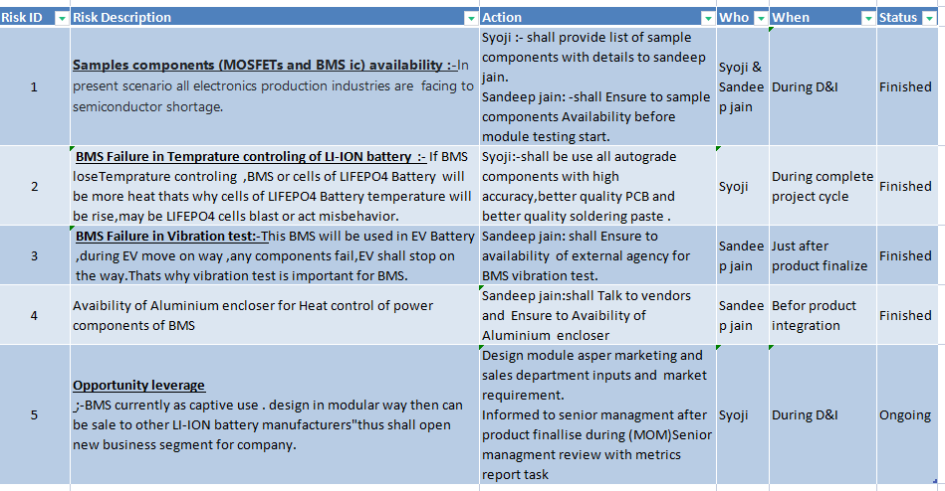
Risk Mitigation Action Plan
http://192.168.100.9:8080/svn/BMS/BMS_20S_40A/GGE300_RSKMTX.xlsx
Outline a course of action for each major risk that is to be mitigated to minimize its likelihood. Periodically discuss with designer and confirm if he is planning for such kind of leaves, then ask him to hand over the design to functional head before he goes on leave.
•Assign responsibility. showed in above table
•Track and monitor the level of risks on a project throughout the Project Lifecycle by a team meeting.

Slide 4
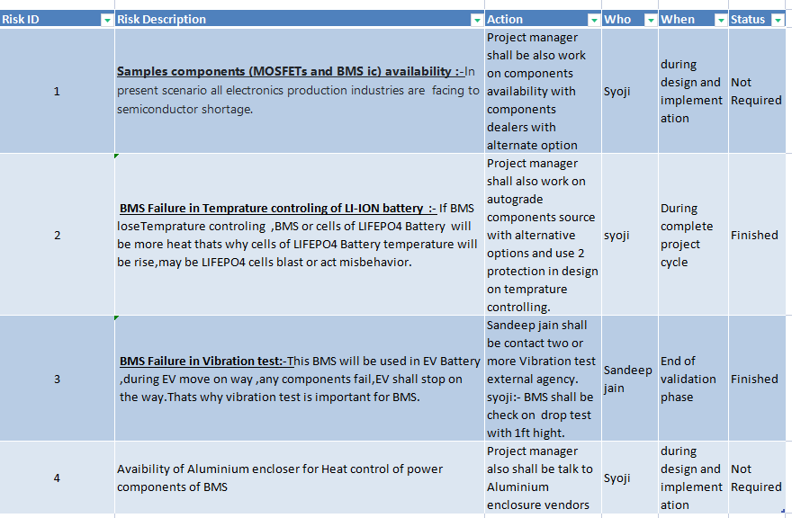
Risk Contingency Action Plan
http://192.168.100.9:8080/svn/BMS/BMS_20S_40A/GGE300_RSKMTX.xlsx
•Outline a course of action for each major risk that is to be mitigated to minimize its likelihood.
•Assign responsibility. Showed above table
•Track and monitor the level of risk on a project throughout the Project Lifecycle by a team meeting.

Slide 5
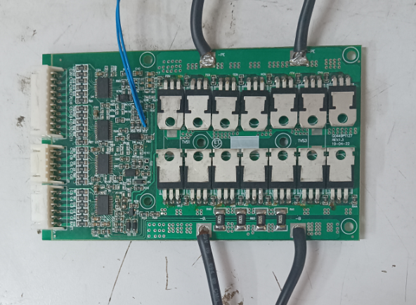
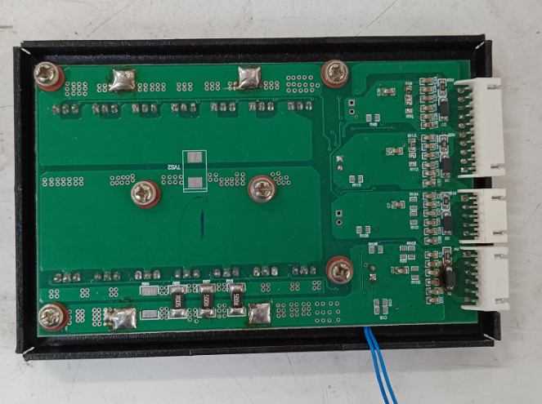
PRODUCT PICTURE

